Slide 1
My Little Pandas (Maura Wernimont, Alissa Waddell, Claudia Gomez-Beltran, Ryan Gfeller)
Kansas Education Level in Relation to Income
March 4, 2019
Notes:
Motivate
o Let me take a poll - just play along - have any of you considered pursuing a higher education degree, whether that means a bachelor's degree, if you don't have that yet, or a master's degree if you have a bachelors or a PHD if you already have a masters
o Raise your hand please
o For those of you that have you'll find this presentation interesting, because we are going to help you figure out the whether there is financial benefit of pursing a higher education degree or not. Those of you that haven't or are not you can snooze now.

Slide 2
Problem
Is there a financial benefit of pursuing higher level education?
How does the county size impact median earnings?
Hypothesis: there is a positive correlation between higher earnings and higher levels of education.
Notes:
Before we jump into the details, I'd like to connect you to what to expect from this presentation and what you will hopefully learn as well.
o Now go into the problem slide
· The 2 main questions we will be answering are:
· And our hypothesis is:
· Also, for honesty purposes, we did not start with this hypothesis. Initially our hypothesis was that lower county density would show less variance on income

Slide 3
Data Used
United State Census American Fact Results
Google maps API
Notes:
The majority of our analysis was driven by using the US Census American results data from the Census Bureau
· The location based analysis you will see came about from using the Google maps API
· In order to better analyze the data we decided as a team to group the data into categories by county. As you can see in the slide the groupings were…you will hear more details on this throughout our presentation

Slide 4
Analysis Notes
Grouped counties into categories:
Rural: 0 to 10k
Suburban: 10 – 20k
Urban: 20 – 100k
Metro: 100k+
Our analysis include a data population of income earners ages 25 and over.
Census data used was 2017
Earnings data used was aggregate 2013 - 2017
Notes:
The Income under HS and Post Graduate had bad values in some cases and were excluded from the data where needed, but the impact was not enough to create a issue in the analysis.
To give you a bit of insight on what each of our team members did. I will only make a few highlights, because the reality is that our project was collaborative for the majority of the project. Meaning that we each would work together to solve any of the issues we were facing while writing the code

Slide 5
Is there a financial benefit of pursuing a higher level education?

Slide 6
Income Summary Description
 | Total Median Earnings | Total Median Earning Less than HS | Total Median Earning HS | Total Median Earning Assoc | Total Median Earning Bach | Total Median Earning Grad
count | 99 | 99 | 99 | 99 | 99 | 99
mean | 33,582.20 | 25,196.74 | 28,809.30 | 32,536.15 | 41,630.52 | 49,075.33
std | 3,771.39 | 6,293.39 | 3,727.50 | 3,950.15 | 6,288.43 | 8,334.12
min | 25,186.00 | 14,141.00 | 20,819.00 | 21,339.00 | 23,750.00 | 27,361.00
25% | 30,989.50 | 20,180.00 | 26,355.00 | 30,129.50 | 38,745.50 | 44,020.50
50% | 32,406.00 | 23,571.00 | 28,616.00 | 31,871.00 | 41,375.00 | 49,107.00
75% | 35,996.00 | 28,551.00 | 31,013.00 | 34,698.50 | 43,906.50 | 53,417.00
max | 48,850.00 | 42,542.00 | 38,611.00 | 43,125.00 | 74,375.00 | 75,949.00
Higher median income through the education categories increases.

Slide 7
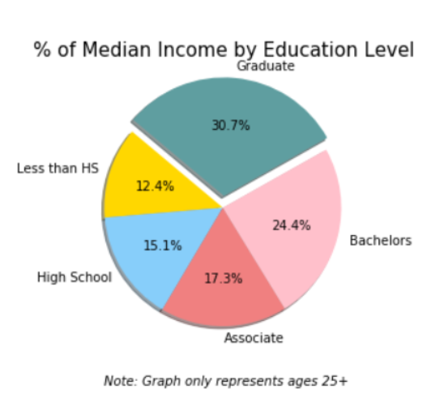
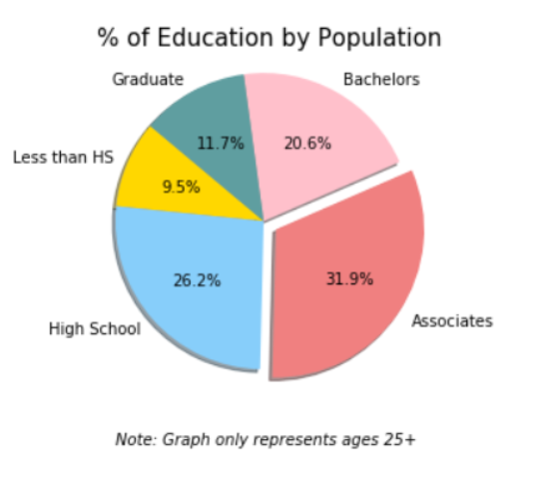
Income Percentages Compared to Education Percentages
Notes:
We determined that 11% of the population has a graduate degree accounting over 30% of the total median income
We can see 26% of the population has a HS diploma but only accounts of 15% of the total median income

Slide 8
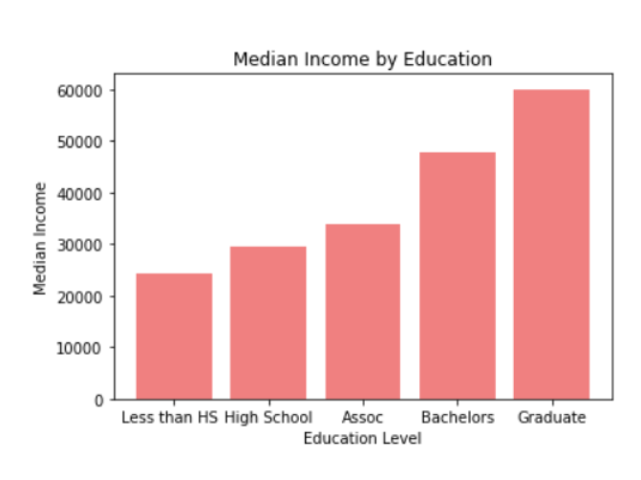
Kansas Median Income by Education Level
Higher levels of education lead to higher median income.

Slide 9
How does the county size impact median earnings?

Slide 10
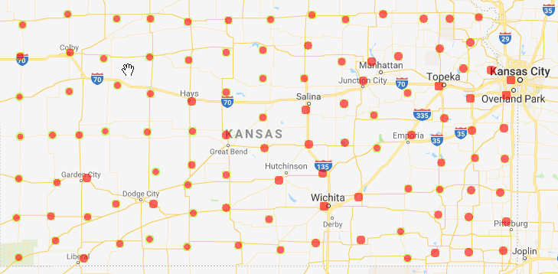
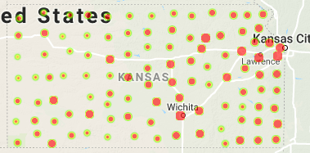
Kansas Population
The figure (above) shows across total population per county the rural communities in Kansas
The figure (below) shows for age 25 and above the trend towards the more urban counties.

Slide 11
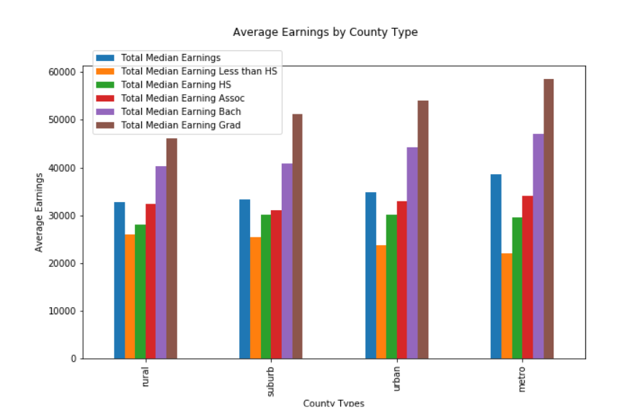
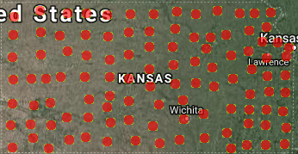
Kansas Average Income
Total Median earnings is slightly higher in the Metro areas, but does appear relatively consistent.
The data shows on average a difference in the income levels between the HS and Associates compared with those with Bachelors and Graduate degrees.
There is no noticeable transition of median income as a whole when looking it on a heat map.

Slide 12
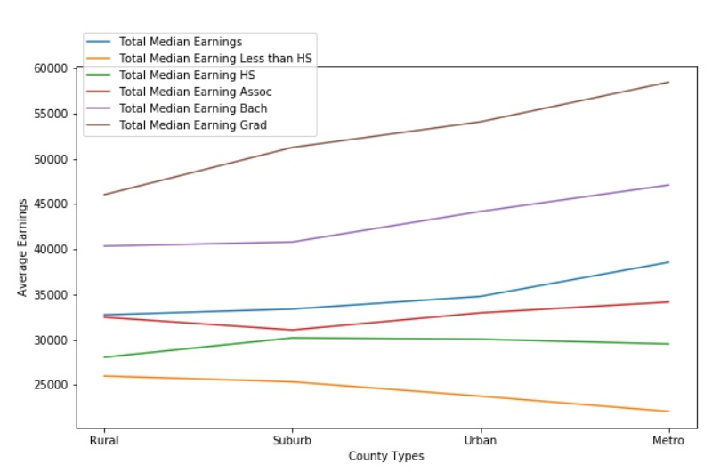
Kansas Average Income
Income disparity in the Urban and Metro areas are noticeable
Bachelors and Graduates median income is above the overall median income.
Degrees appear to influence income more in the larger counties possibly due to additional competition.
There is a benefit to getting a masters or professional degree regardless of the county.
High school degrees are critical to remaining above the poverty line especially in the Urban and Metro counties.

Slide 13
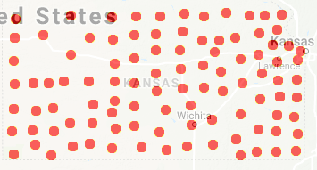
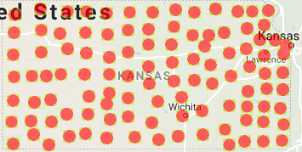
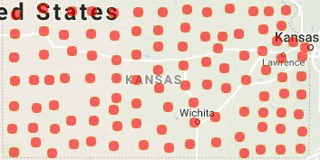
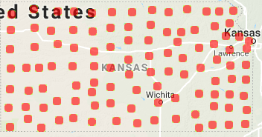
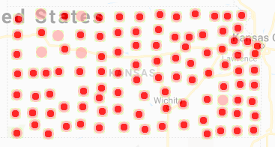

Income Level Maps by Education Type and County
A
B
C
D
F
E
Less than HS
High School
Associates
D. Bachelors
E. Professional (PD)
F. HS and PD
Notes:
There is not a large enough gap to show the difference in the median incomes across each of the categories within the maps.

Slide 14
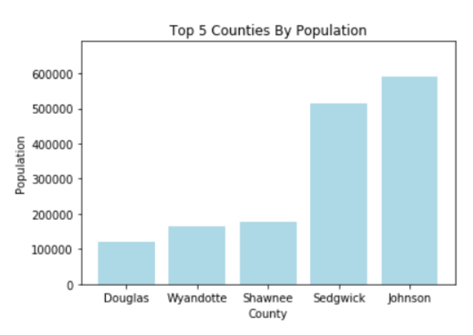
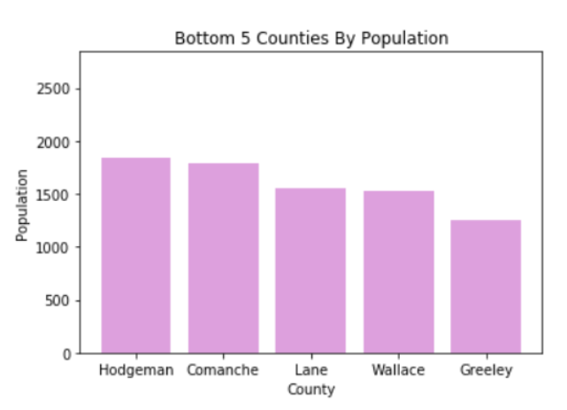
Top and Bottom 5 Counties by Population
The top 5 counties accounted for 53.9% of the population
The bottom 5 counties accounted for 0.27% of the population

Slide 15
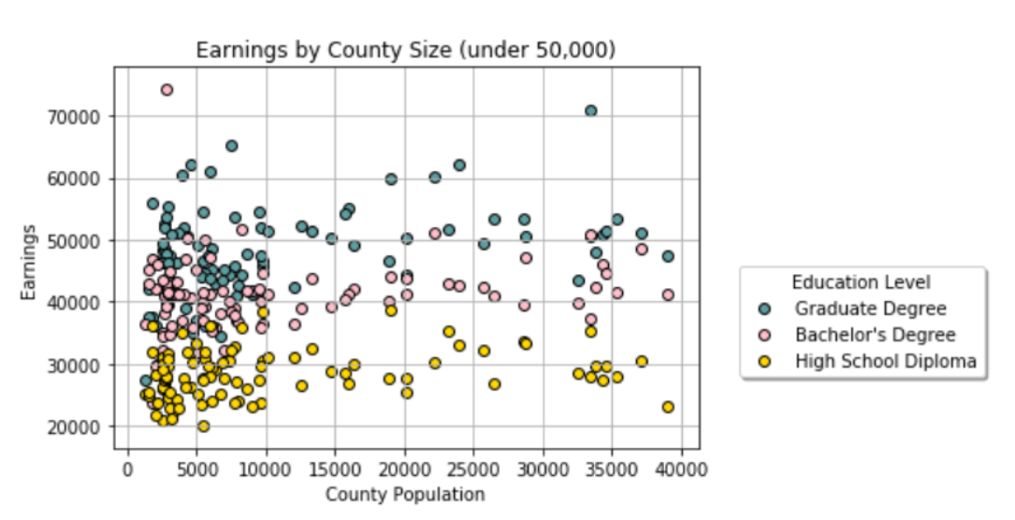
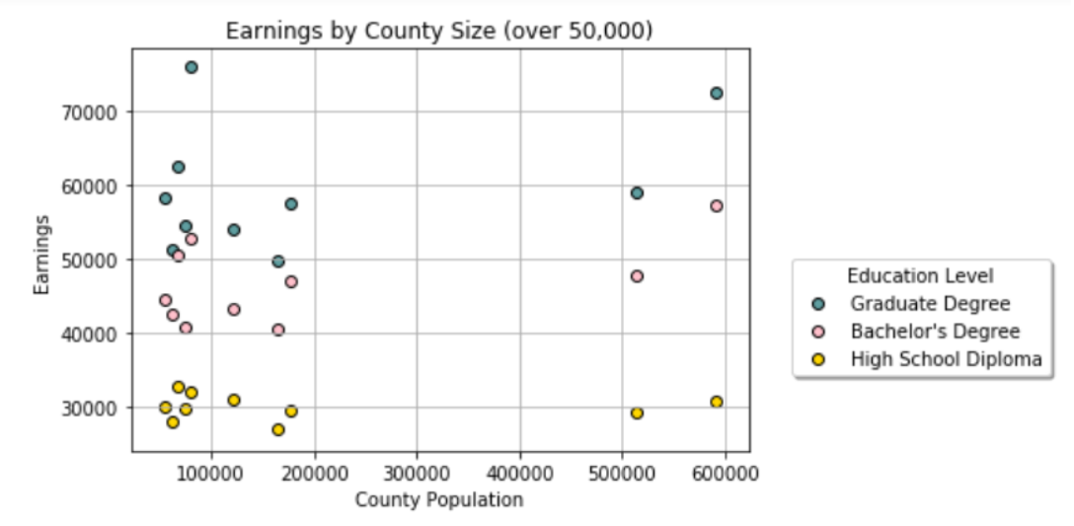
Earnings by County Size

Slide 16
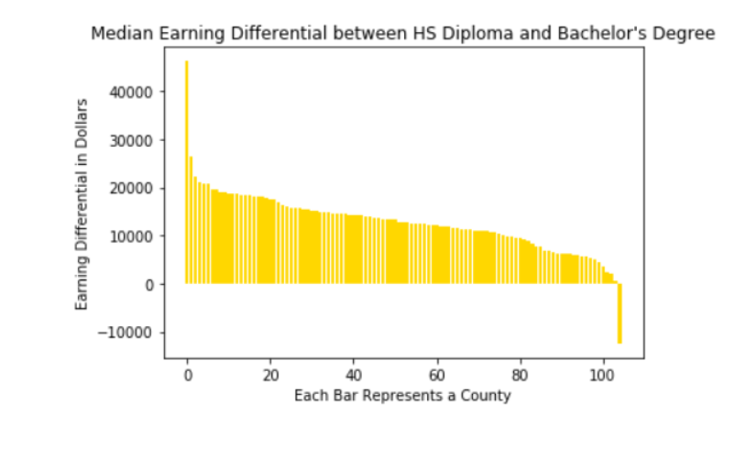
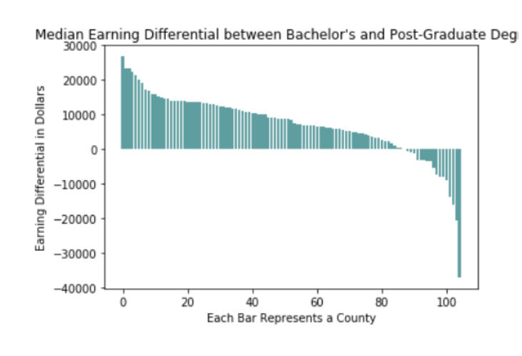
Earnings Differential by Education Level
Notes:
Maura – it looks like the bottom graph was cutoff and “degree” is not fully showing.

Slide 17
Q&A

